Slide 1

Marketing and Sales Tools for Small Publishers
@BeatBarblan @Bowker
Notes:
Good afternoon and welcome to Marketing and Sales Tools for Small and Self Publishers! My Name is Beat Barblan and I’m Director of Identifier Services at Bowker. Among other things, we run the ISBN Agency for the US and it’s territories as well as for Australia. We handle registrations for the brand new ISNI standard, the ISTC and the DOI. We also provide marketing and sales services and tools for publishers of all sizes. Today, I will focus on the small and the self-publisher.
During today’s session, I would like to do three things:
Share a few thoughts about metadata and its relation to sales, especially in the digital world and in light of the recent findings by a research project conducted by Nielsen in the UK and their subsequent white paper on what they have found.
Give you an overview of some tools that help level the playing field for small publishers and make it more likely that readers will connect with and purchase your titles
Answer any questions you may have about metadata, the tools available to you as well as established and emerging standards in the publishing industry

Slide 2


Our books are great but not selling as well as they should.
Notes:
So, you are a small publisher and you have these great books you hope to sell.
The books are good; well written with great illustrations, but they not selling very well.
You are convinced that it is simply because people are not finding them; people don’t know about your books.
You can’t afford a large marketing budget, so you need to find inexpensive ways to connect your potential readers and buyers with your content.

Slide 3

I finished writing my first book. Now I want to sell it. What should I do?
Notes:
Or maybe you are a self publisher.
You just finished writing your book and now you are ready go public with it.
What are your next steps?
How do you compete in a world with very large publishers that can invest heavily in marketing their titles?

Slide 4

Rich metadata is
fundamental!
Notes:
Metadata is how your customers find your book
The richer your metadata, the more likely it is that your customers will find your books and purchase them.

Slide 5
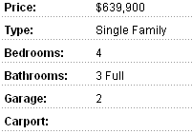
Would you buy a house based on this information?
Notes:
Let’s say you need to buy a house. You are not sure what kind of house exactly you need; you know the area but don’t have time to go there right now, so you turn to the internet for an initial search. You stumble upon this information
Nobody would buy a house based on this limited metadata.
There simply isn’t enough information there to you give you a sense of whether this would be a good house for you and your family
If you searched on the internet for a location, this house wouldn’t even show up in your search results

Slide 6

How about this one?
Notes:
This is already much better.
You get a sense of what the house looks like. You see the trees in the background, the lawn in the front….

Slide 7
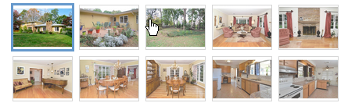
This one?
Notes:
This is even better. You actually have multiple pictures and you can see what different rooms in the house look like
You are beginning to get a “feel” for what it might be like to be inside this house and to step outside onto the lawn

Slide 8
What about this one?
Spacious 3.500 sq ft Custom Home! This very special property exudes charm & character with an eclectic mix of old and new. Set in most desirable Washington Headquarters neighborhood in historic…
Notes:
Better yet. You actually get some details about the size of the house as well as some details about the area where the house is located

Slide 9
“As the internet becomes the consumer’s primary source of information, it’s likely that customers will increasingly discover and learn about books via the information they can find about that book, rather than the physical product itself.”
-The Link Between Metadata and Sales - Nielsen

Slide 10
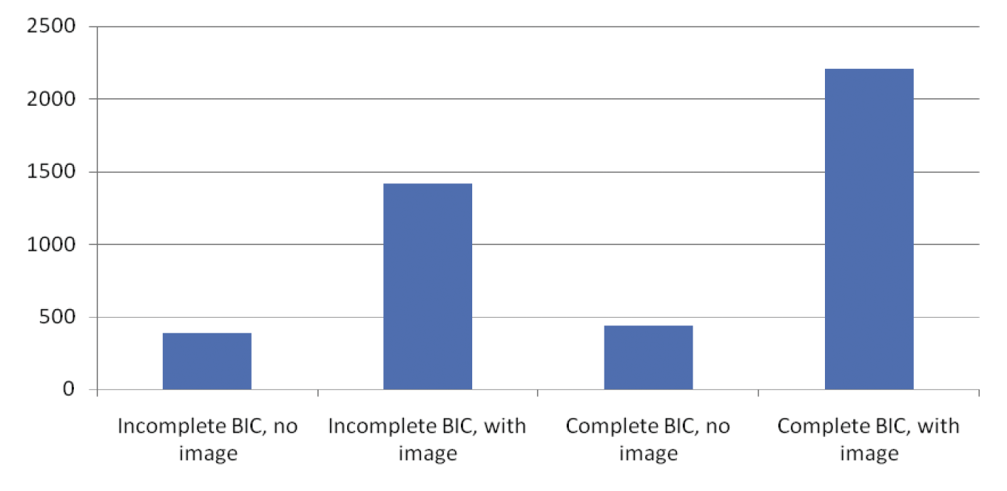
Sales volume with vs without cover image
-The Link Between Metadata and Sales - Nielsen
Notes:
What a difference an image can make
In their recent study on the effects of metadata on sales, Nielsen found that the mere addition of cover images could make an enormous difference in sales volume
● ISBN
● Title
● Product form
● Main Book Industry Communication (BIC) subject category
● Imprint name
● Publication date
● Cover image
● At least one supplier name
● Availability status
● GBP retail price including VAT
● Statement of rights relating to UK

Slide 11

But what does it look like?
Spacious 3.500 sq ft Custom Home! This very special property exudes charm & character with an eclectic mix of old and new. Set in most desirable Washington Headquarters neighborhood in historic…
Notes:
Remember the real estate add. Here we have a fair amount of data but no image. Not so good….

Slide 12
Spacious 3.500 sq ft Custom Home! This very special property exudes charm & character with an eclectic mix of old and new. Set in most desirable Washington Headquarters neighborhood in historic…
Notes:
What a difference images can make!

Slide 13
Some Key finding in Nielsen metadata study
Titles that meet the BIC basic standard have 98% higher average sales
Addition of an image has a 268% impact on average sales for items without BIC basic metadata
Addition of an image has a 473% impact on average sales for items with BIC basic metadata
-The Link Between Metadata and Sales - Nielsen
Notes:
The positive impact of supplying complete BIC Basic data and an image is clear. Records without complete BIC Basic data or an
image sell on average 385 copies. Adding an image sees sales per ISBN increase to 1,416, a 268% boost. Records with complete BIC
Basic data but no image have average sales under 437 copies, but when we look at records with all of the necessary data and image
requirements, average sales reach 2,205. This represents an increase of 473% in comparison to those records which have neither
the complete BIC Basic data elements or an image.
The Link Between Metadata and Sales - Nielsen

Slide 14

Metadata
Is King!
1 enhanced metadata element: +55%
2 enhanced metadata elements: +71%
3 enhanced metadata elements: +120%
4 enhanced metadata elements: +178%
-The Link Between Metadata and Sales - Nielsen
Notes:
Enhanced metadata fields improve sales
BIC’s enhanced metadata elements
-Short description
-Long description
-Review
-Author biography
-Table of contents

Slide 15
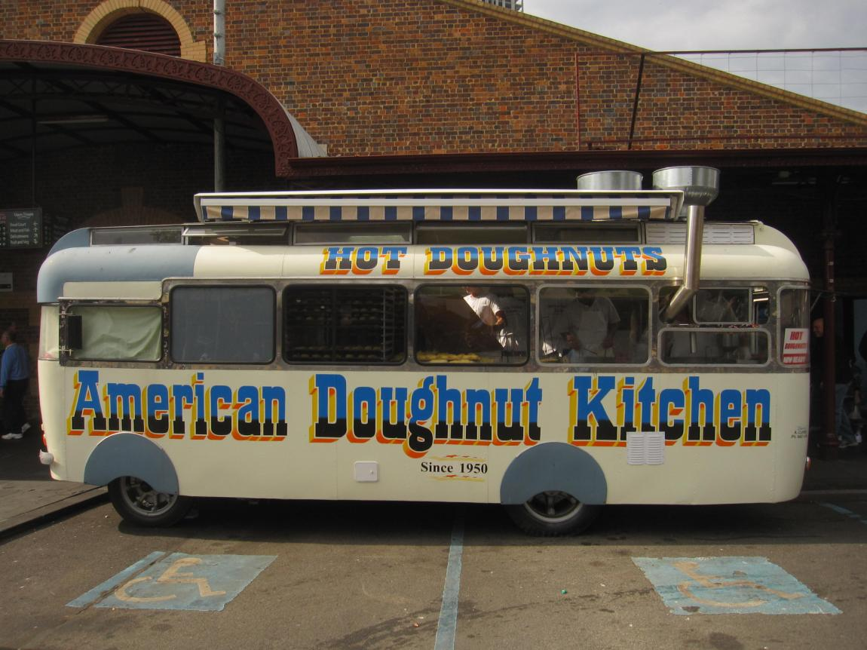
Notes:
So now you’ve submitted your metadata and you are ready for some additional tools to help market your books.

Slide 16

The in-store experience
Notes:
In a physical world, people are in a store and leaf through (and perhaps read part of) your title
It’s a little like speed-dating. You walk up to a book, spend a few minutes with it and decide whether you are interested
How do you create this experience for your potential buyers in a virtual/digital world?

Slide 17
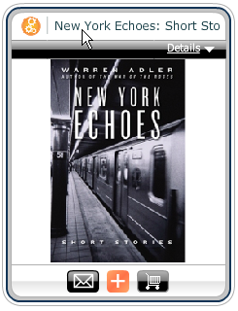
Meet my book
Notes:
There are tools that can help do this:
Give users a “feel” for your title and let them get to know your book
Then give them a way to purchase your title, right then and there

Slide 18
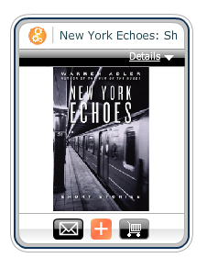
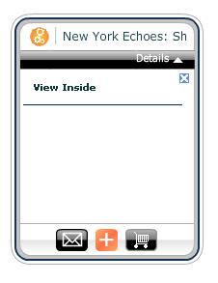
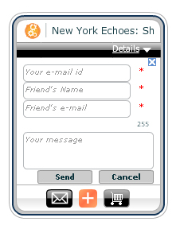
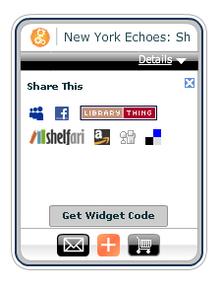
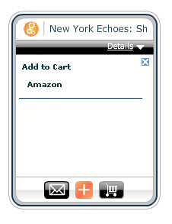
Show…Share…Sell
Sample
Email
Share
Sell
Displays automatically on www.Bookwire.com
Notes:
Just like we’ve seen in the real estate world, unless people can actually get a hands on experience of a product, whether it be a house or a book, you will have to create that experience for them in some other way.
A good description and pictures are a good start, but still very limited.
So, in addition to good metadata, you also want to avail yourself of other tools that can help you market your titles

Slide 19
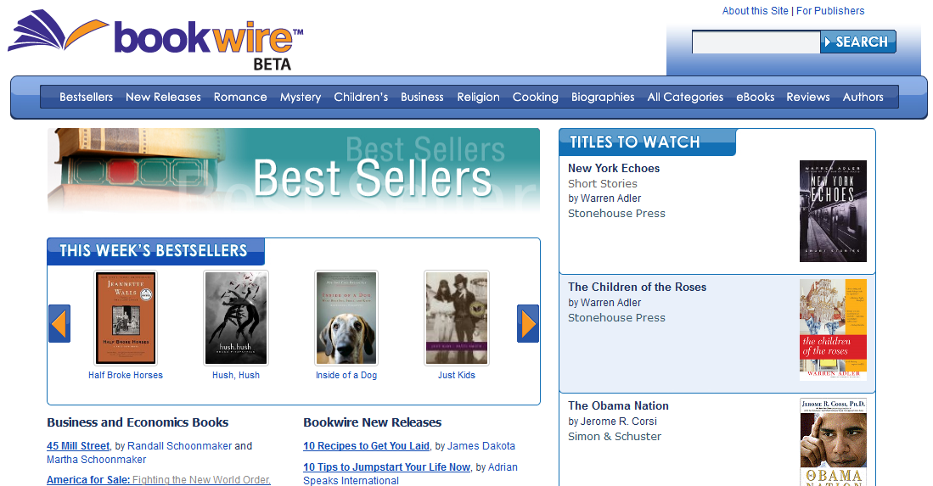
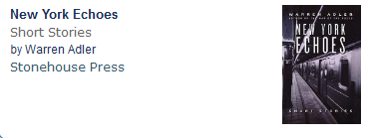
Notes:
What is Bookwire? A site to make it easier for people to discover, evaluate, order, and experience books.
It’s powered by the Books in Print database and offers information on book titles, including print, e-books and audio books.

Slide 20
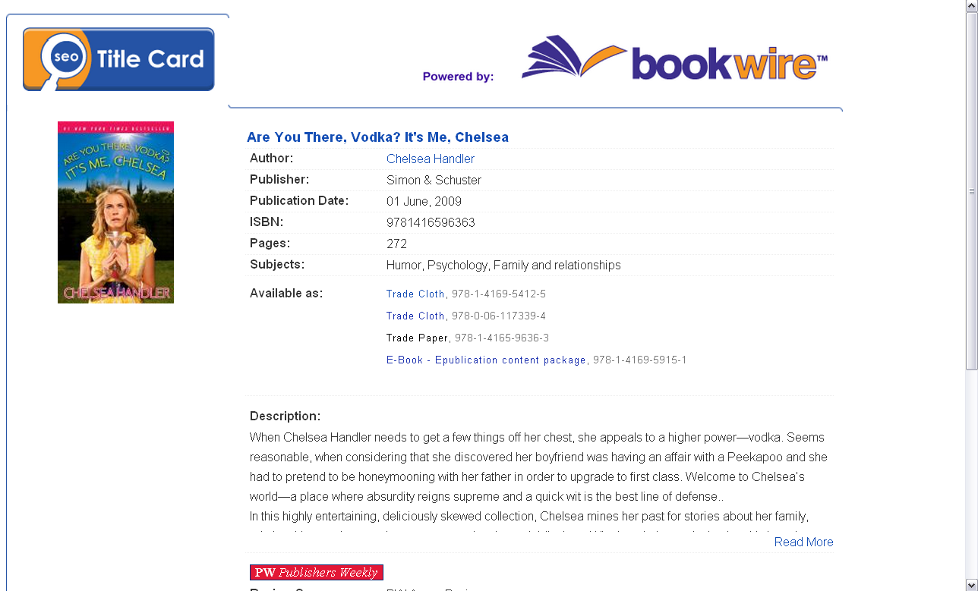
Notes:
Without the Bowker Book Sale widget

Slide 21
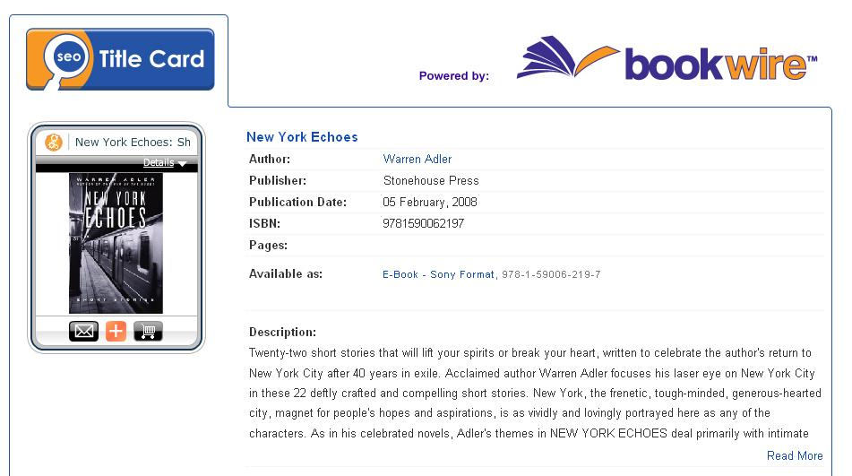
Notes:
Every Bowker Book Sale widget appears automatically on the title card for that book

Slide 22

Everybody should read my book!
Notes:
As a small or self publisher, you want to find ways to make your book available to as many people as possible.
Without spending a fortune.

Slide 23
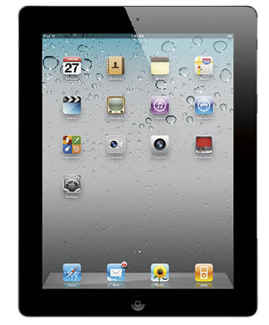
Download my book from iTunes!
Notes:
With a few simple steps you can create an App for your book
FYI 25 million iPads have been sold as of June 2011

Slide 24

Notes:
The Book as an app is a favorite for parents reading to their children who like the bright colors

Slide 25

Notes:
Professional who want access to their titles wherever and whenever

Slide 26

Notes:
People who need to share information at work

Slide 27

Notes:
Kids at school

Slide 28

Notes:
People who like to read outside of the box

Slide 29

We have published this book also as an iPad App.
Notes:
We’ve created an app for this book

Slide 30
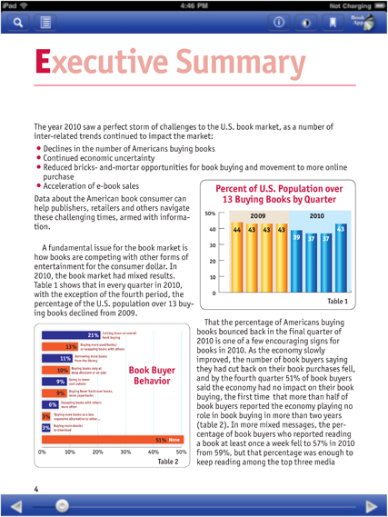
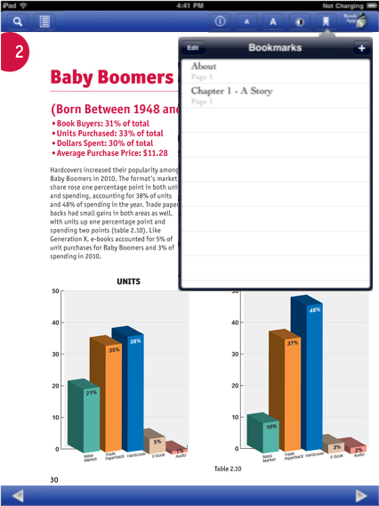
Notes:
We felt it was a good way for us to distribute the title and give people another way to access our content.
Who wants to hear about one more way to help market and sell your book?

Slide 31

Notes:
Ok. Here we go

Slide 32
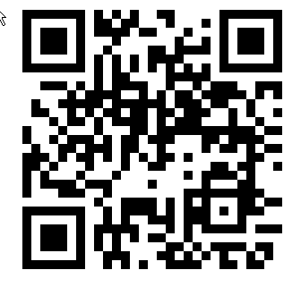
Notes:
You might have seen these around town. QR codes (Quick Response Code).
Invented by a Toyota subsidiary in 1994 to track vehicles during the manufacturing process
Designed to allow its content to be decoded at high speeds
It has become popular in other industries as well
According to comScore, 20.1 million mobile phone owners in the U.S. used their devices to scan a QR code in the three-month average period ending October 2011
This QR Code resolves to MyIdentifiers.com

Slide 33
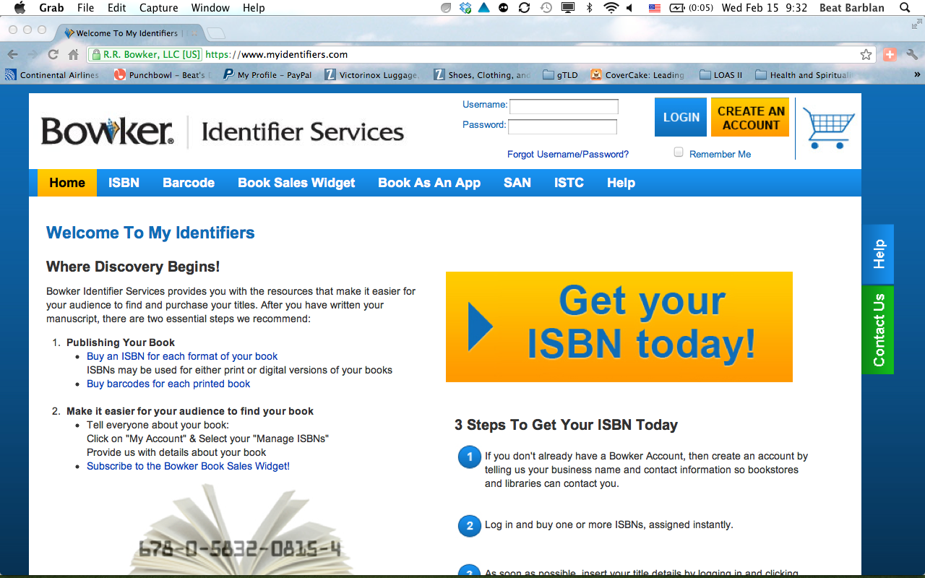

Slide 34
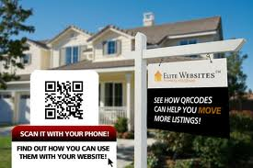
Where can I get more information on this property quickly?
Notes:
Back to the real estate example.
Increasingly you will see QR codes used in real estate signs.
Scanning these codes might open the realtors web site where you can find more detailed information on the property

Slide 35
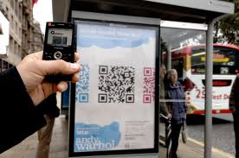
Notes:
You can find QR codes linking to detailed information in public spaces, like this bus station

Slide 36
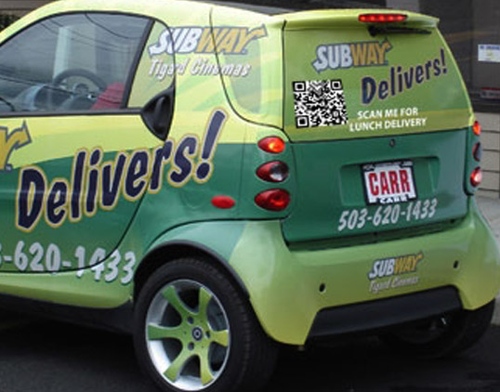
Notes:
Or this car

Slide 37
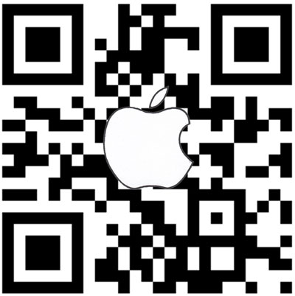
Notes:
Here’s an apple QR code

Slide 38
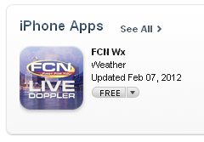
Notes:
It links directly to here from where you can download an app

Slide 39
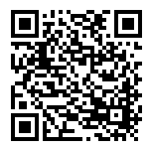
Notes:
This QR code resolves to this page

Slide 40
Notes:
The title page for this book that includes the widget from where your potential customer can…

Slide 41
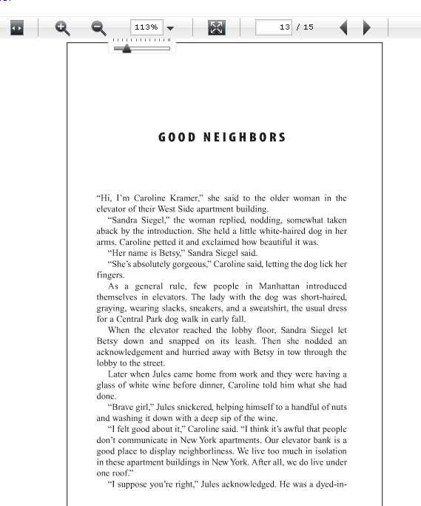
Read a sample page of the book
Notes:
Get a view inside of the book and read a few pages

Slide 42
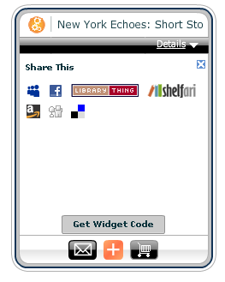
Share
the
book
Notes:
Share the book with friends and family via facebook, for example, or by adding the code to her web site

Slide 43
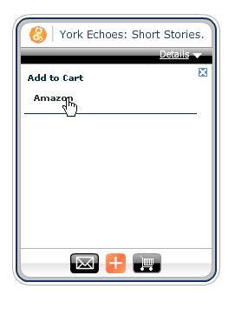
Buy
the
Book!
Notes:
And finally buy the book which sort of brings us back full circle.

Slide 44
Four simple things you can do as a small publisher
Provide Good Metadata
Use the Bowker Book Sale Widget
Turn your book into an iPad App
Use QR Codes
Notes:
So here are four simple things you can do to help market and sell your books.

Slide 45
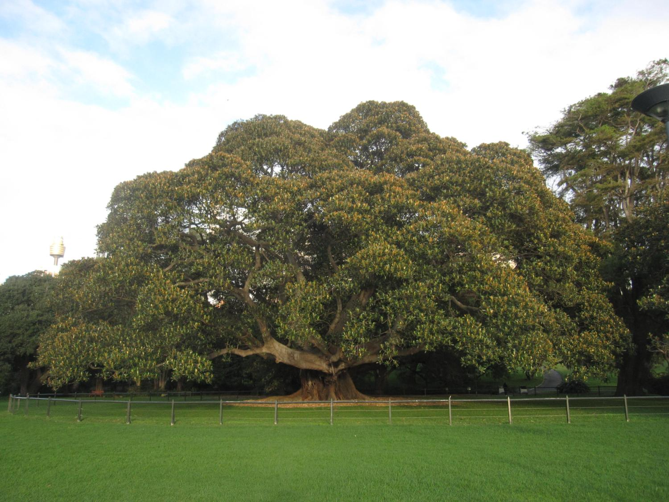
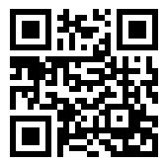
Thank You!
FOR MORE INFORMATION
MyIdentifiers.com
beat.barblan@bowker.com
@BeatBarblan
@Bowker

